Slide 1
Machine Learning

Slide 2
What is Machine Leaning
Machine learning is a subset of artificial intelligence in the field of computer science that often uses statistical techniques to give computers the ability to "learn" (i.e., progressively improve performance on a specific task) with data, without being explicitly programmed.

Slide 3
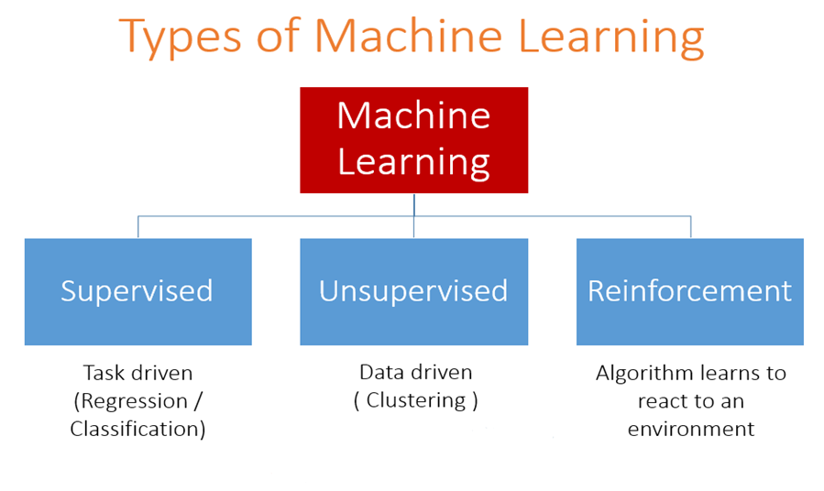

Slide 4
Supervised Learning

Slide 5
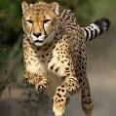
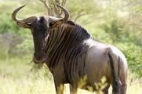
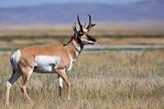

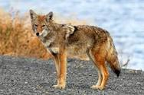
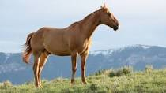

Classification Example
Class A
Class B
Class - ?

Slide 6
Features – properties of the data
Labels – what we want to predict

Slide 7
x2
Decision boundary
Green or blue?
0
x1

